Slide 1
Analysis Report on Bank Transactions of Merchants

Slide 2
Data Summary
Part 1

Slide 3
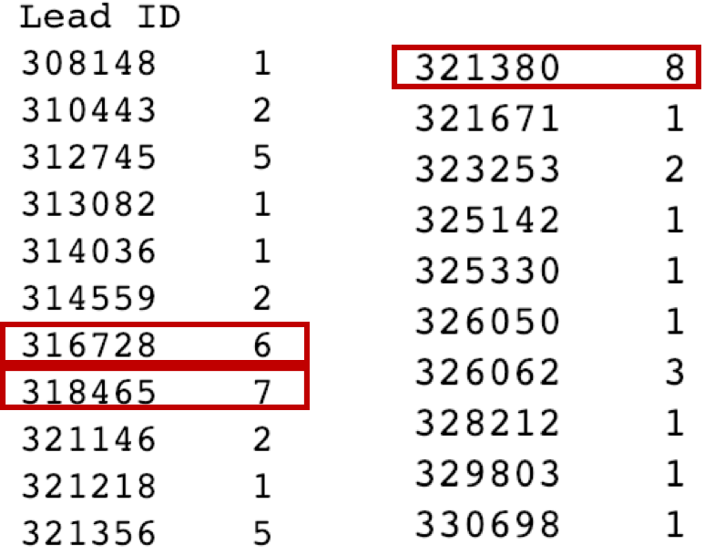
1. Number of Bank Accounts for Each Merchant
Out of 21 merchants, 11 merchants have only one bank account. In other words, 52% of merchants have business with a certain number of partners.

Slide 4
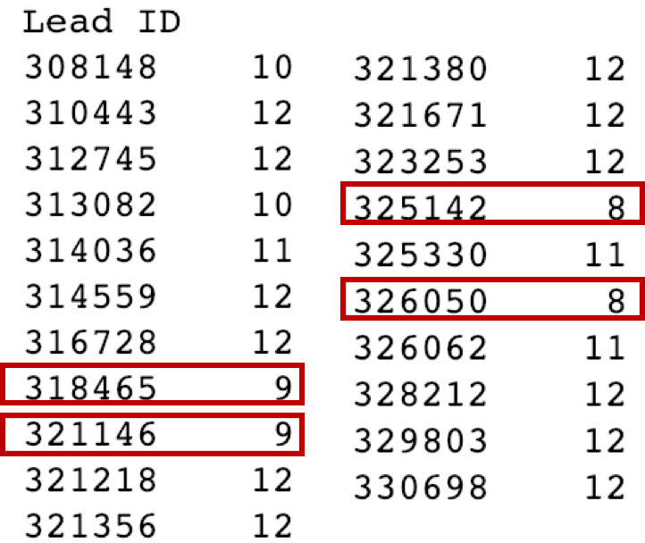
2. Number of Months In Business
On average, merchants have transactions over 11 months among the whole year.
For merchants with only 8 months, this might indicates they are out of business for around 4 months in a year.

Slide 5
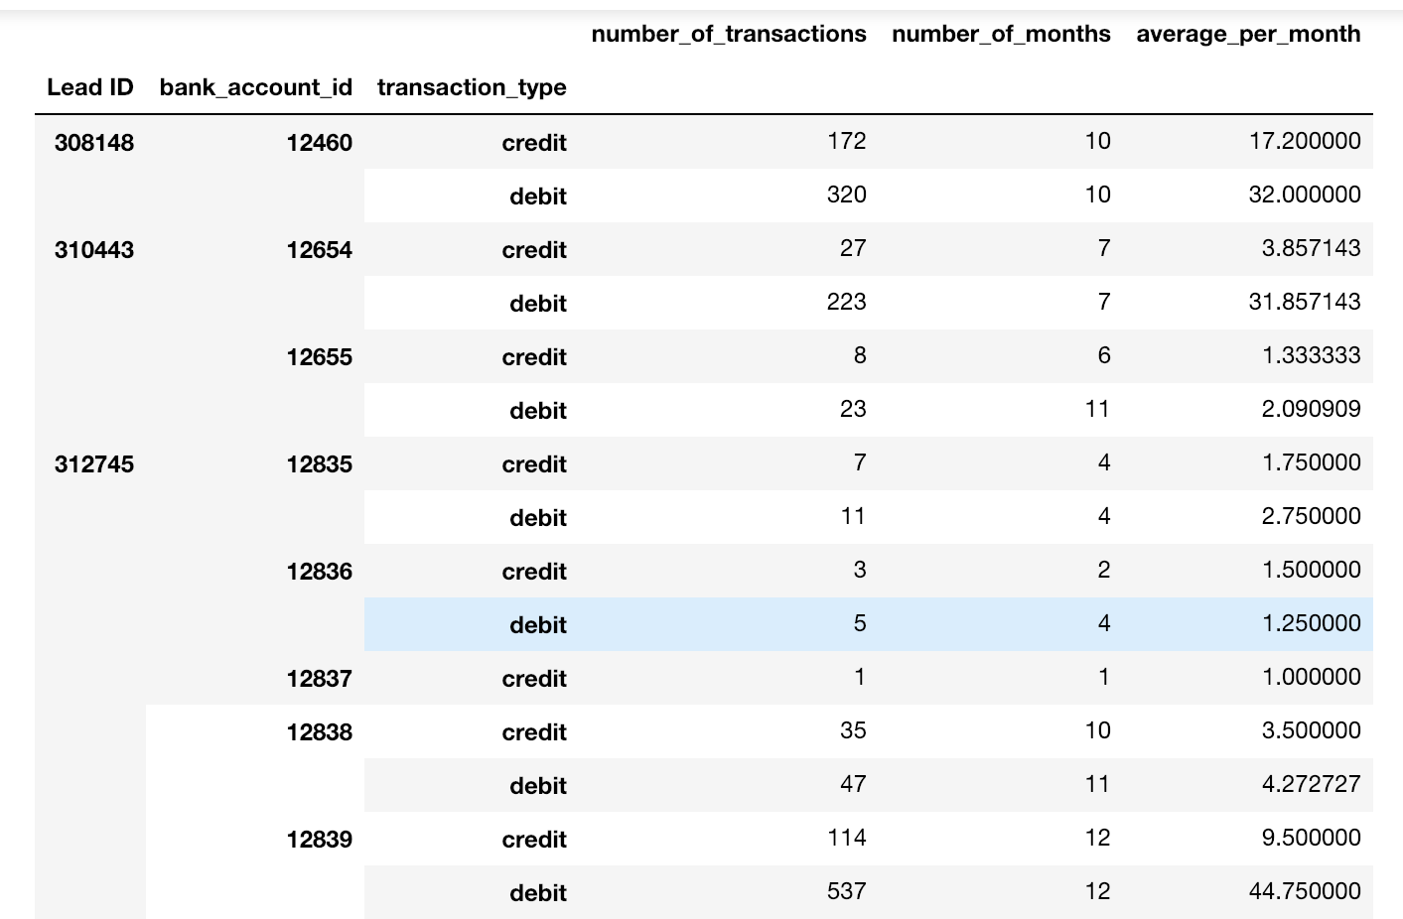
3. Total and Average Number of Transactions
It can be observed that not all bank accounts are equally used for each merchant. Some accounts have significantly more transactions per month.
The frequency of deposits (credit) per month is lower than withdrawals.

Slide 6
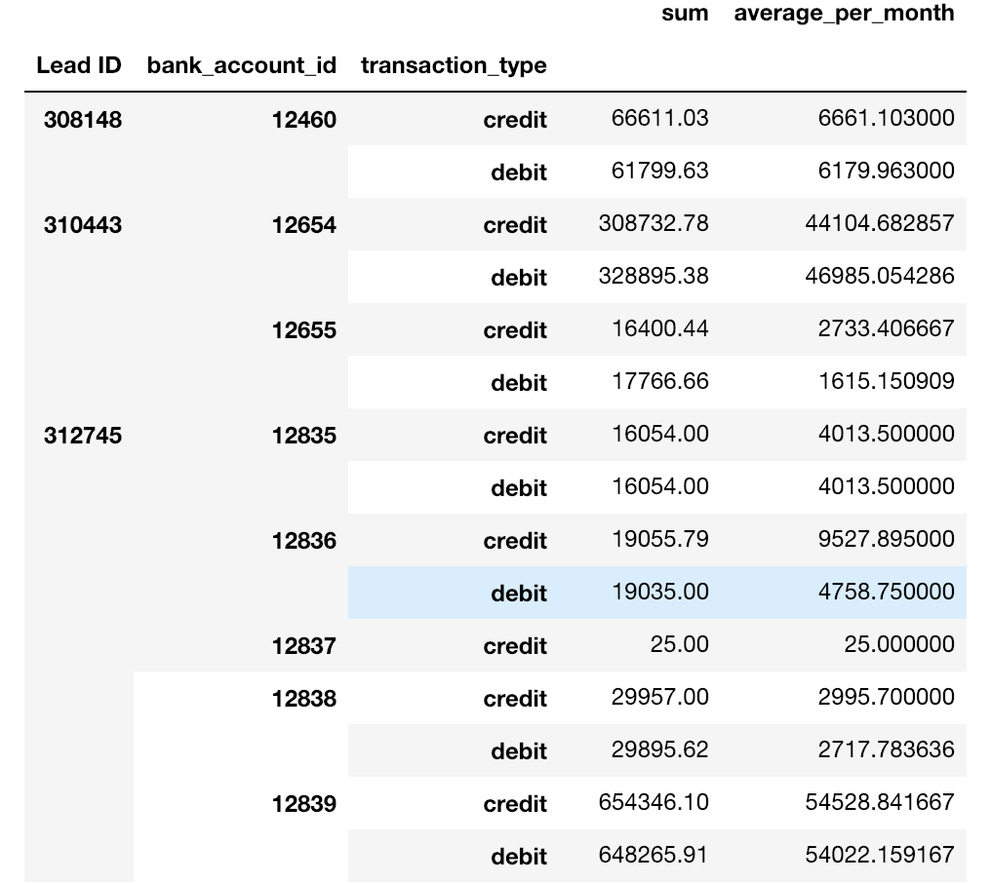
4. Total and Average Dollar Amount of Transactions
Comparing to previous slide, the bank accounts with more transactions per month also shows more dollar amount on these transactions.
Further, the monthly dollar value of deposits and withdrawals for these bank accounts are balanced.

Slide 7
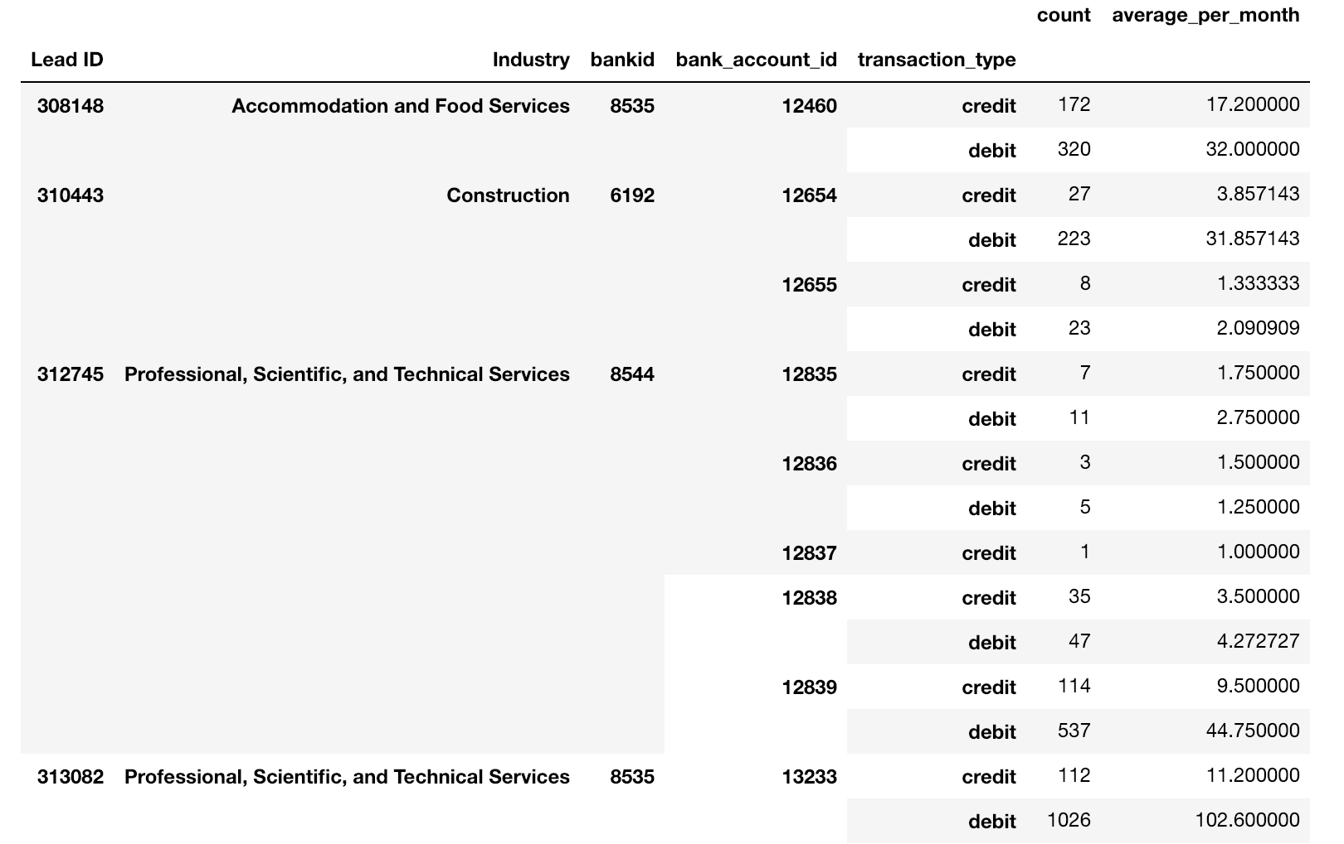
5. Transaction Details on Industry & Bank Level
Total and Average Number of Transactions
All merchants have business only in one industry. Most of them have transactions with only one bank.
For merchants 316728 and 321380, only they have business with 2 banks.

Slide 8
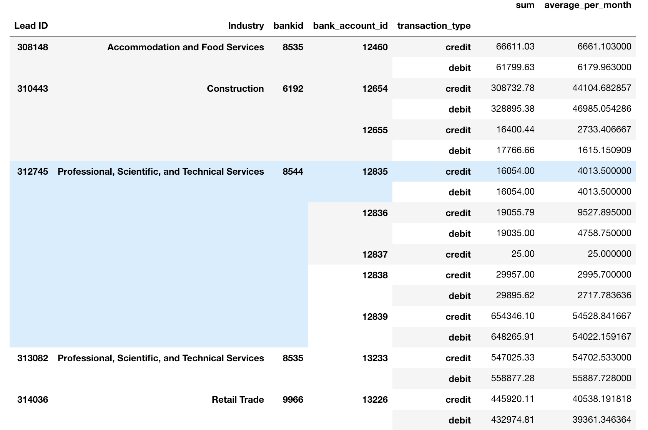
Total and Average Dollar Amount of Transactions
Among different industries, Construction and Insurance related business have significantly larger cash flow per month than other industries.

Slide 9
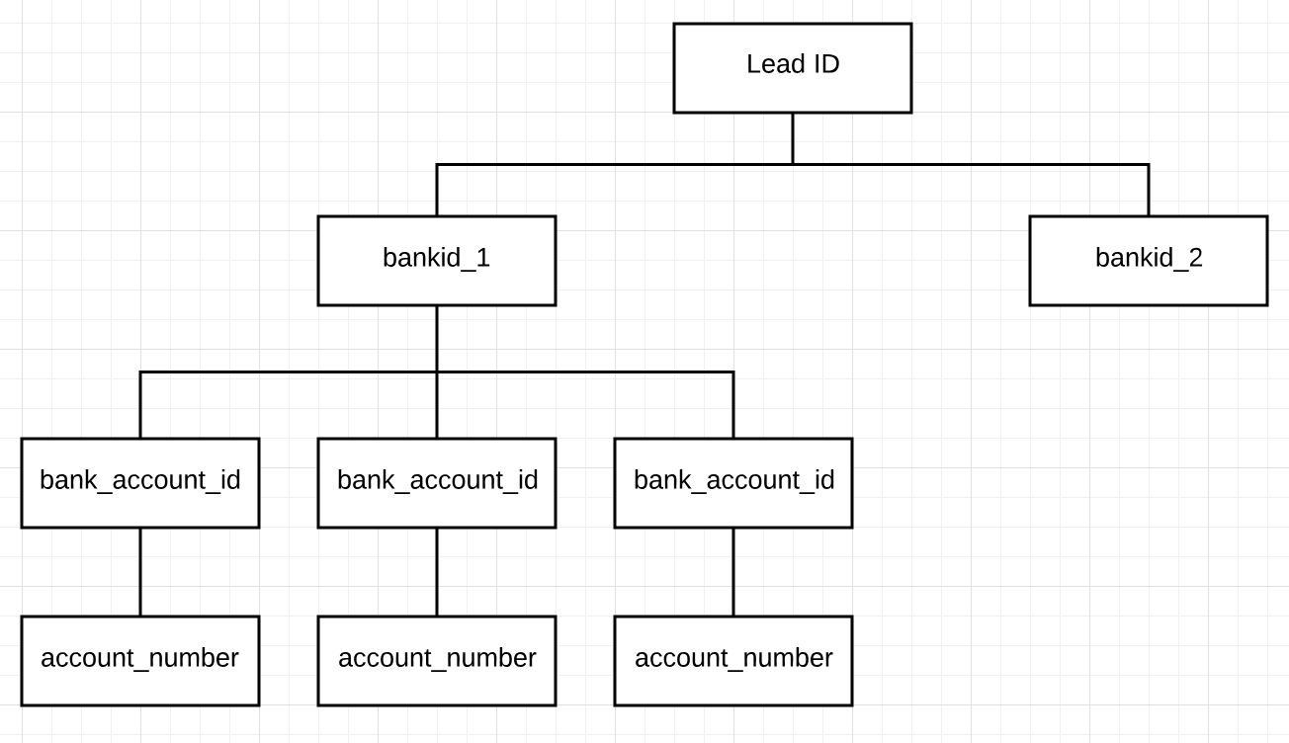
6. Relationship Between IDs
For every ‘Lead ID’, it has several ‘bankid’.
Each ‘bankid’ can have several ‘bank_account_id’.
Every ‘bank_account_id’ have only one specific corresponding ‘account_number’, except some missing data.

Slide 10
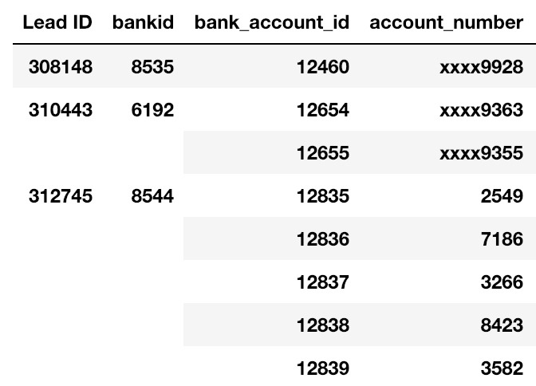
For example, ‘Lead ID’ 312745 has business with one bank, so linked to one ‘bankid’.
Inside this bank, there are multiple accounts involved. For ‘bankid’ 8544, it has five ‘bank_accounts_id’.
Finally, for each ‘bank_account_id’, it only have one corresponding ‘account_number’.

Slide 11
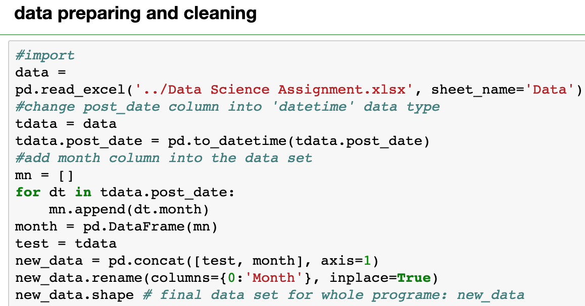
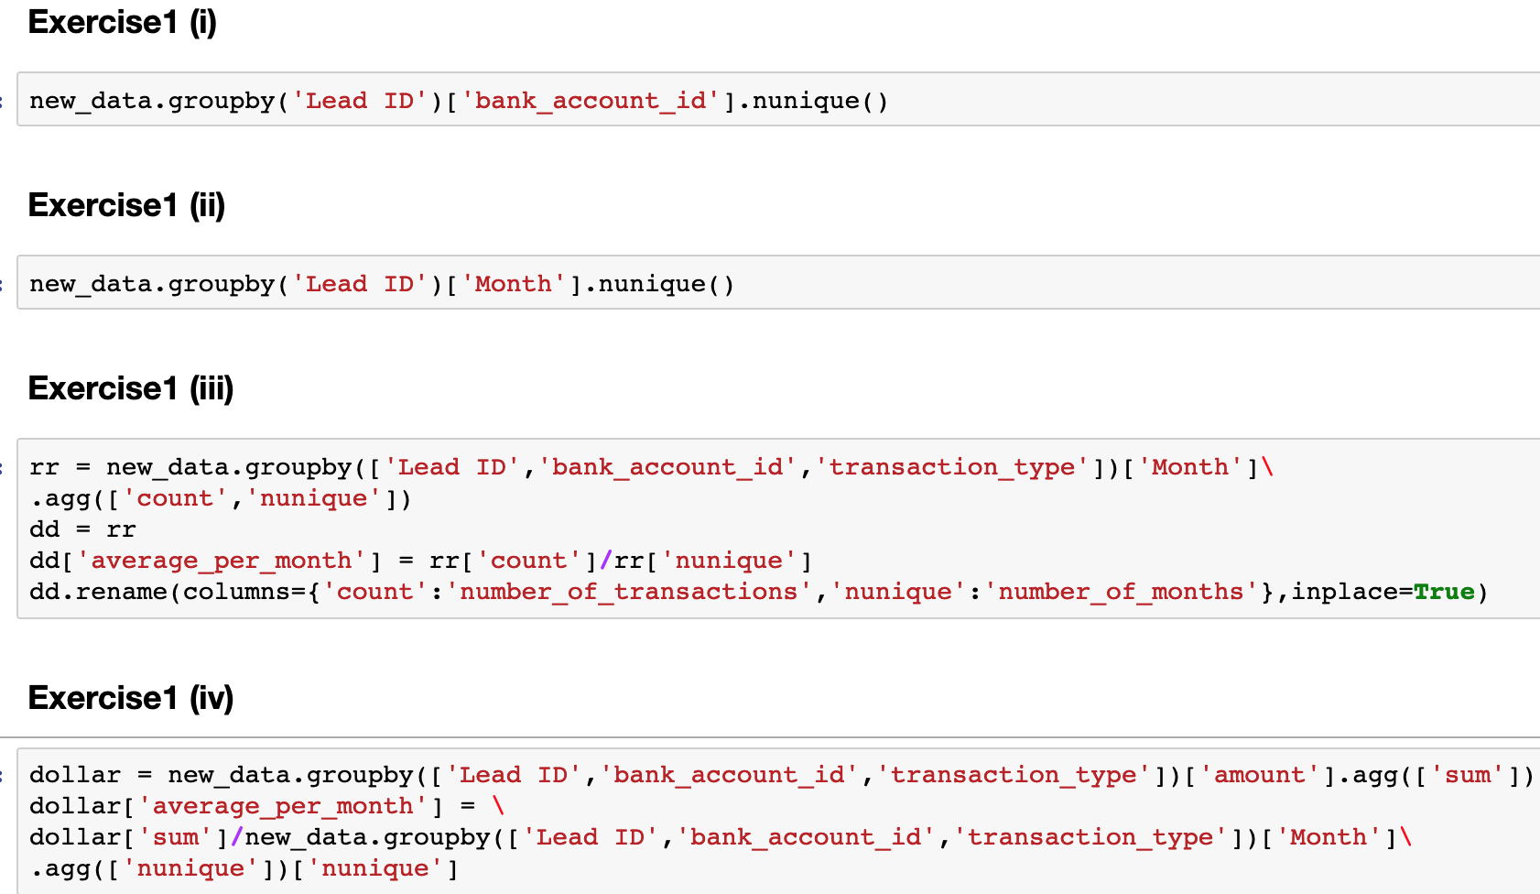
Appendix for Code
All coding is done in Python, and part of data presenting is enhanced using Excel.
Original data has been clean and renamed as ‘new_data’, and then used for the entire program.

Slide 12
Explore Transactions on Daily Basis
Part 2&3

Slide 13
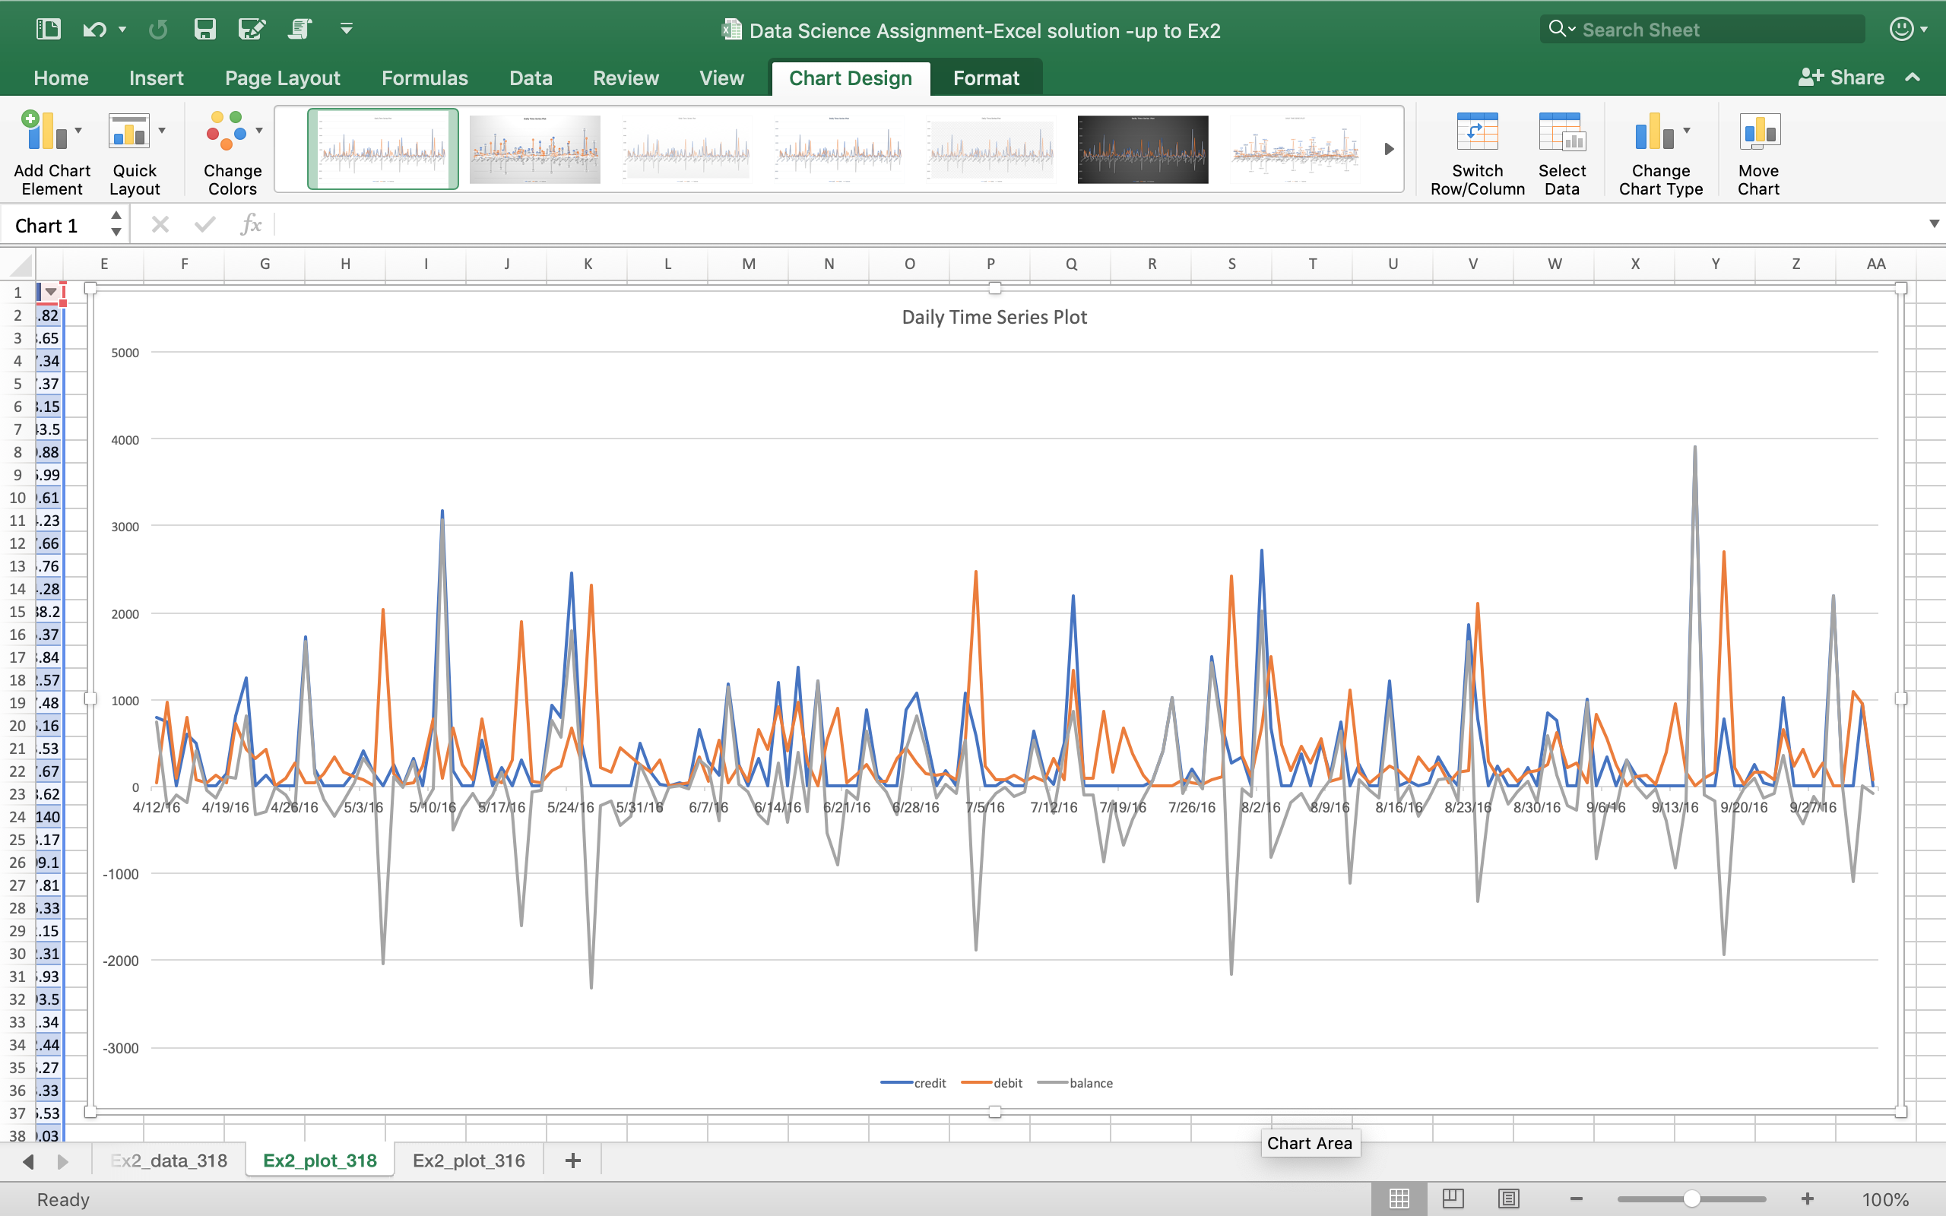
Time Series Plot for One Account
Lead ID:318465
Bank_account_id:13419
This cash flow time series plot represents a common time series for a continuously operated business.
The peaks of credit and debit are close to each other, which could indicates the merchant are closing its balance in time.
The merchant might have a healthy financial and business condition.

Slide 14
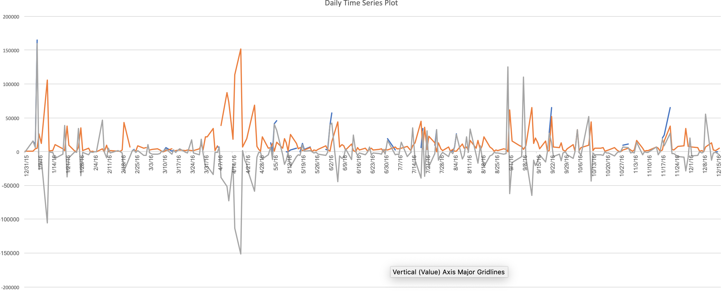
Lead ID:316728
Bank_account_id:13232
Cash flow of this account shows a unstable pattern of the business.
The blue line which represents the deposits occur only in a very short time period.
In contrast, the withdrawals are continuously happening and have more dollar amount than deposits. This could possibly indicate a reduced income and a potential default.

Slide 15
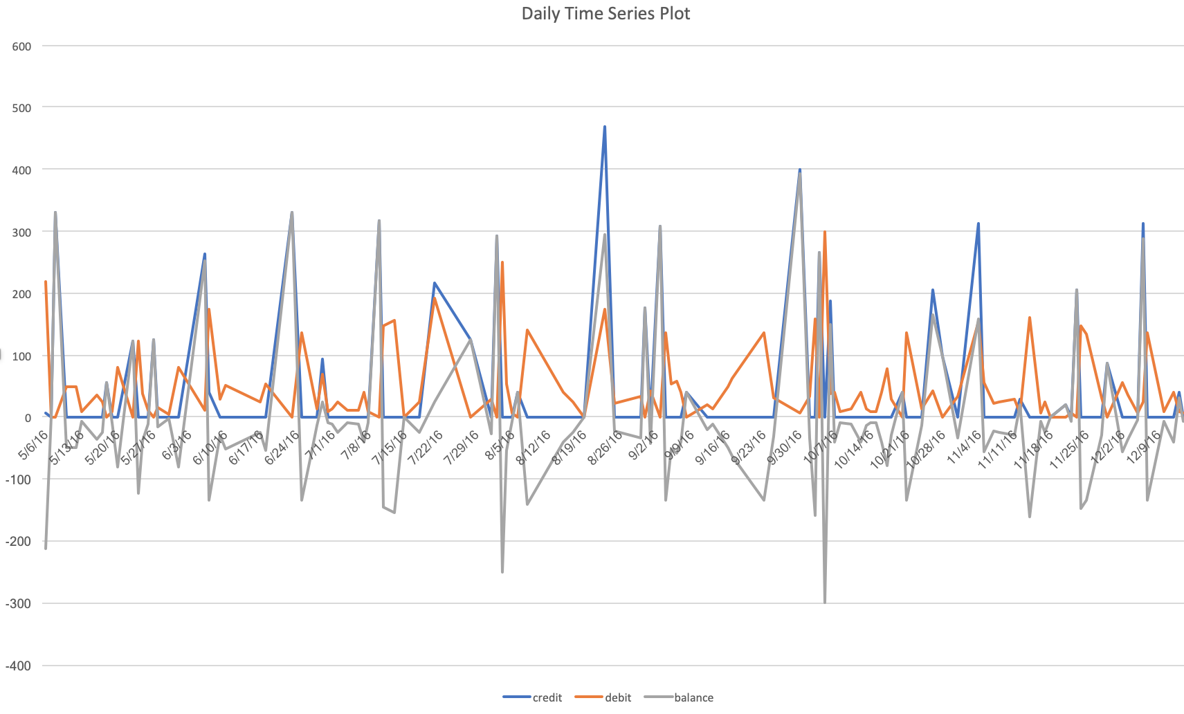
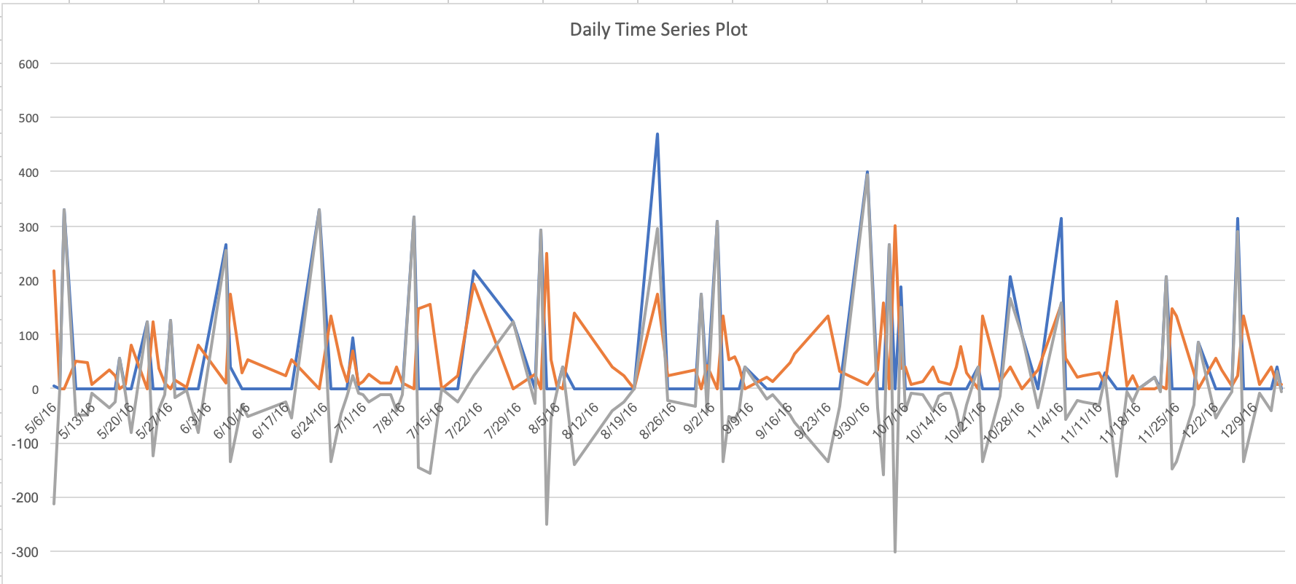
Time Series Plot for Different Accounts
Lead ID:318465
Bank_account_id:13422
Bank_account_id:13423

Slide 16
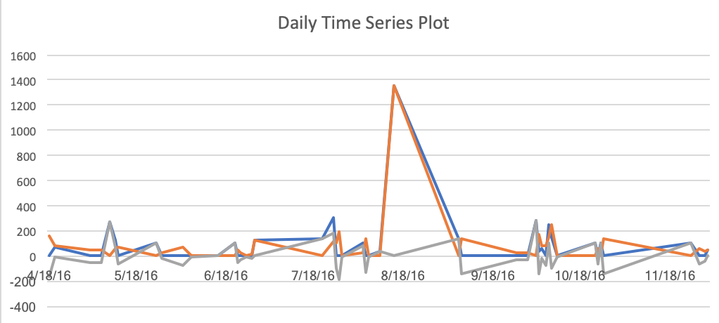
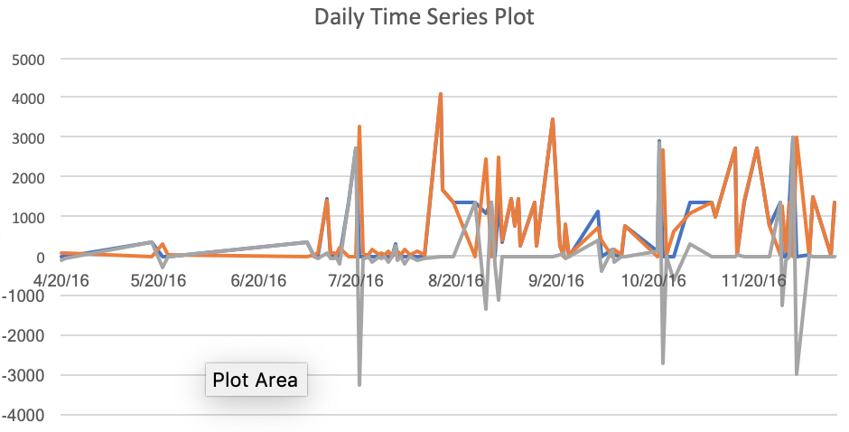
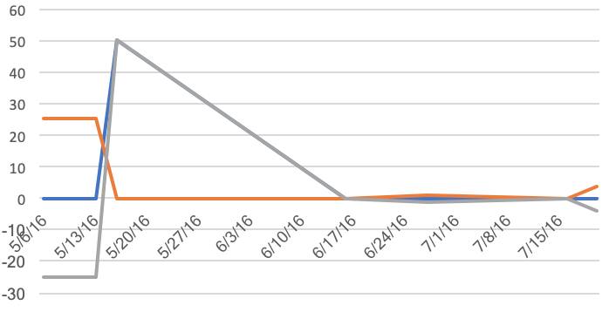
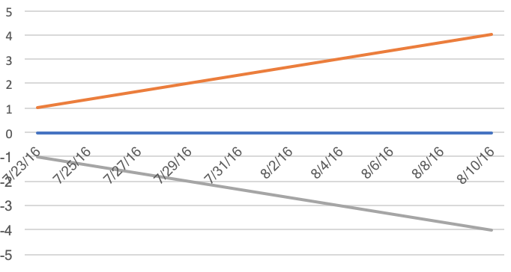
Lead ID:318465
Bank_account_id:13424
Bank_account_id:13425
Bank_account_id:13420
Bank_account_id:13421

Slide 17
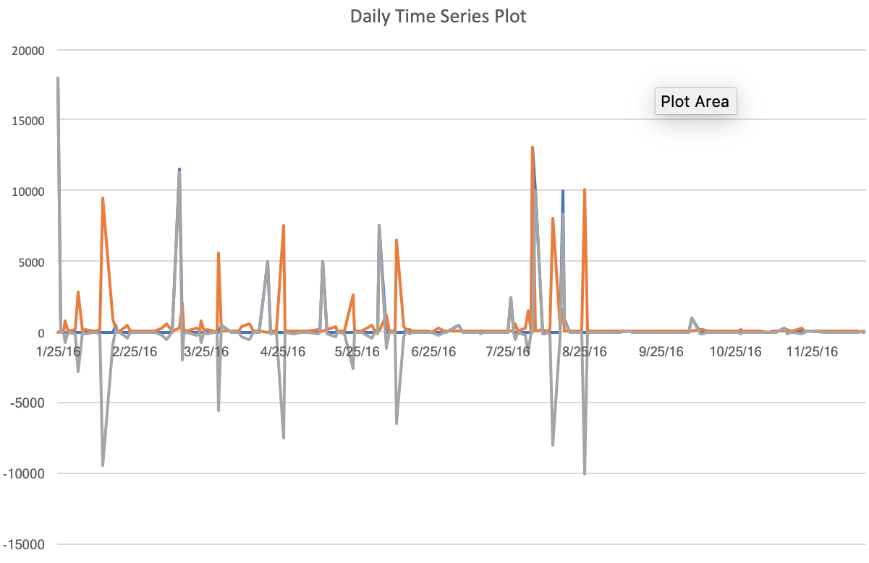
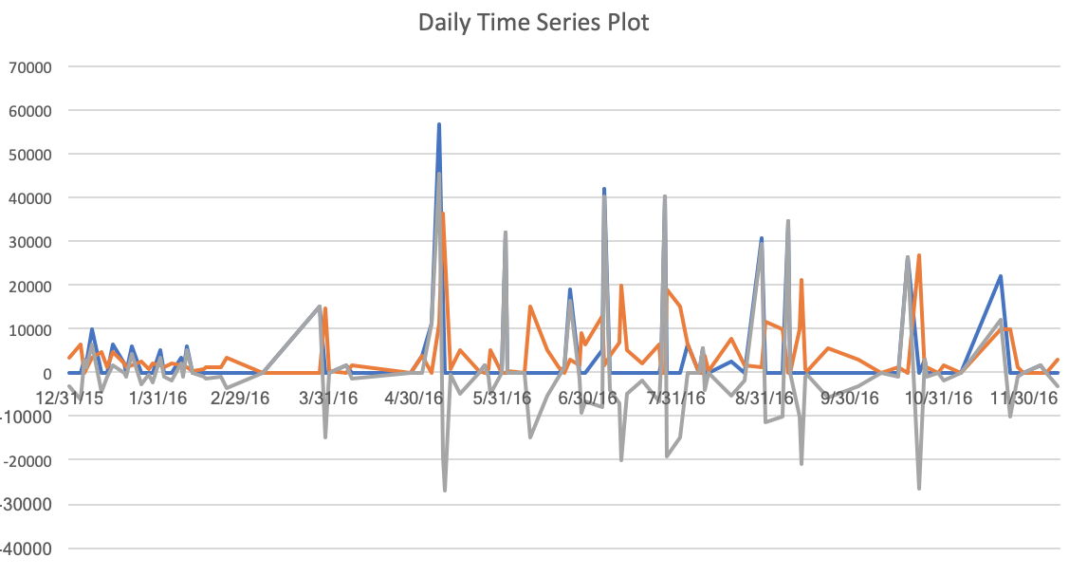
Lead ID:316728
Bank_account_id:13228
Bank_account_id:13234

Slide 18
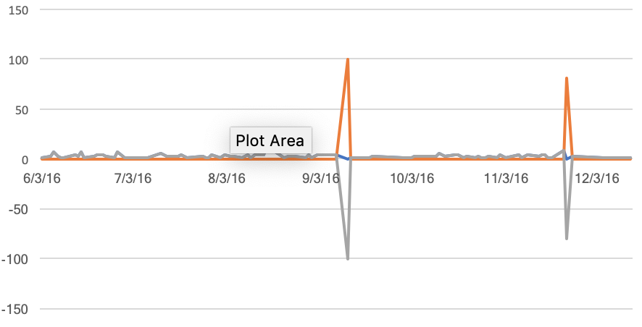
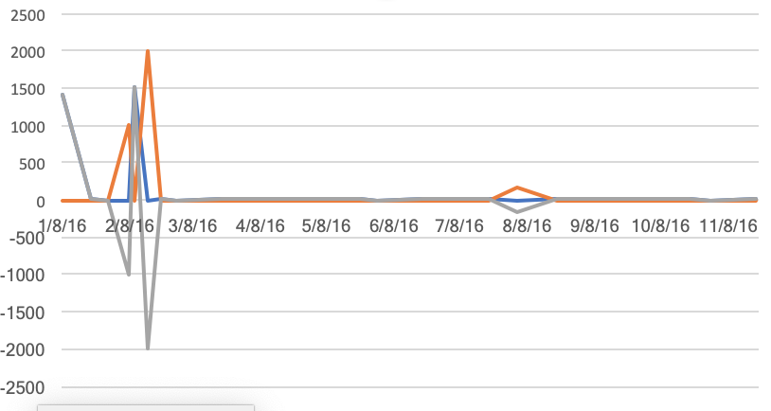
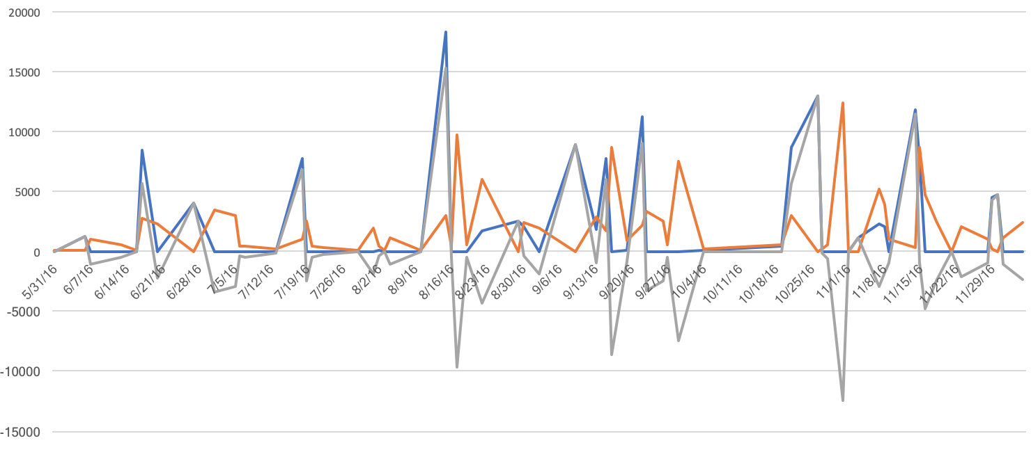
Bank_account_id:13230
Bank_account_id:13235
Bank_account_id:13272

Slide 19
Lead ID 318465:
Most bank accounts of this merchant are actively managed and there are significantly dollar value and number of transactions within these accounts.
The balance of all accounts is fluctuated around the horizon, which means the merchant is repaying its loan on time and in full amount. This indicates a good financial situation and profitability of the business.
Base on the time series plot, the possibility of defaulting inside this year should be considered as low.
Lead ID 316728:
Only two bank accounts are actively managed. For accounts like 13230 and 13235, there are many small dollar-value transactions keep happening. This might indicate there are manually deposits and withdrawals which aiming at pretending these accounts are still in business.
The balance of all accounts is still near the horizon. The loan are still being paid back and no default detected yet.
Base on the time series plot, the possibility of defaulting inside this year should still be considered as low, but the profitability of business should be monitored.

Slide 20
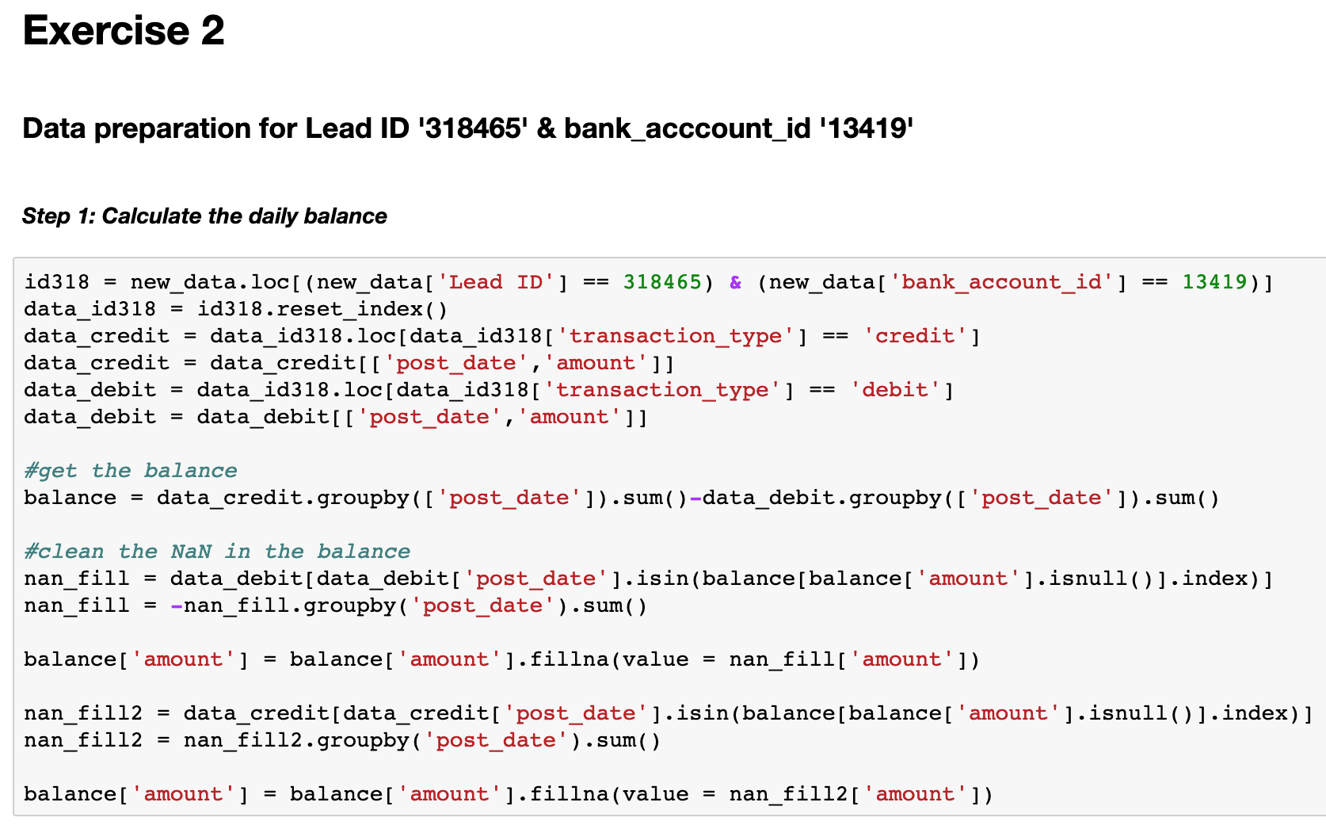
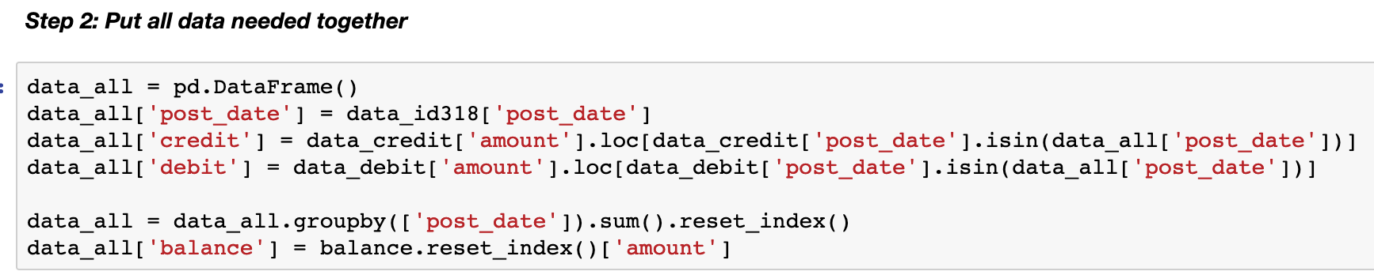
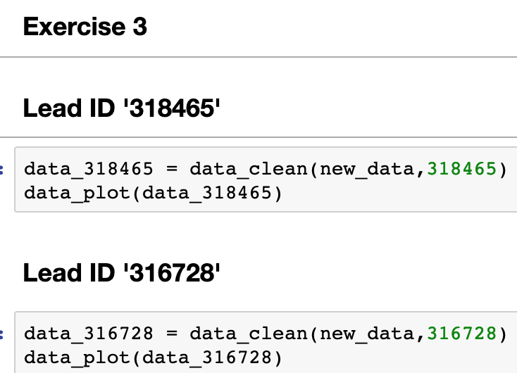
Appendix for Code
All the steps of data cleaning of Exercise 2 is shown here. After cleaning data, they are exported to Excel for better graphic presenting. A Python plotting solution is also provided in the code.
For Exercise 3, the data cleaning and plotting process are packaged in functions. By calling the function, it can automatically process the data as required.

Slide 21
Explore Cash Flow
Part 4

Slide 22
Top 5 Deposits/Total Deposits
On average, the top 5 largest deposits occupy 25% of the total deposits.
For merchants with high percentage, they usually have limited number of transactions, which causes the deposits are not spread over the whole time periods.

Slide 23
Average Number of Days Between Withdrawals
The grand average of days between withdrawals is 1 day for all merchants.
For most merchants, they need to get funded for every business day. Merchants with higher number of days usually have a more discrete distribution of deposits and withdrawals (higher one-time cash payment or requirement).

Slide 24
Coefficient of Variance of Daily Balance
CV of daily balance is computed by using the mean divided by standard deviation. The higher the CV, the greater the level of dispersion around the mean.
In a simple way, the higher the CV, the more extremely daily balance fluctuates, which indicates a higher requirement of available cash flows.

Slide 25
Other potential dimensions
1. Average days between deposits
Similar to withdrawals, the gap between deposits reflect how often the merchant repay the loan.
The mean of average days between deposits is 2.5 days, much longer than the time between withdrawals
2. Active accounts
For merchants with many different bank accounts, it is necessary to see how active these accounts are. This might tell which account should be closely monitored.
For merchants with multiple accounts, the transaction frequencies are significantly different from each other.
Usually, majority of all transactions happened in one account.

Slide 26
3. Major time period for deposit/withdrawals
Based on the frequency and dollar value of transactions, a certain time period could be defined that most of business activities happened in this time period. By exploring cash flow in the time period, it could inform the health of the business.
For merchant 318465 and its account 13419, majority for cash transactions happened in November.
In general, its business happened mainly in the third and forth quarter.
4. Duration for collecting all the loan
Assuming the current pace and dollar amount of repayment will remain same in future, the time merchants need to pay their loan could be computed.
For this account, by using regression, it predicts that the remaining running balance could be recovered in about one month.

Slide 27
Transaction Clusters
Part 5

Slide 28
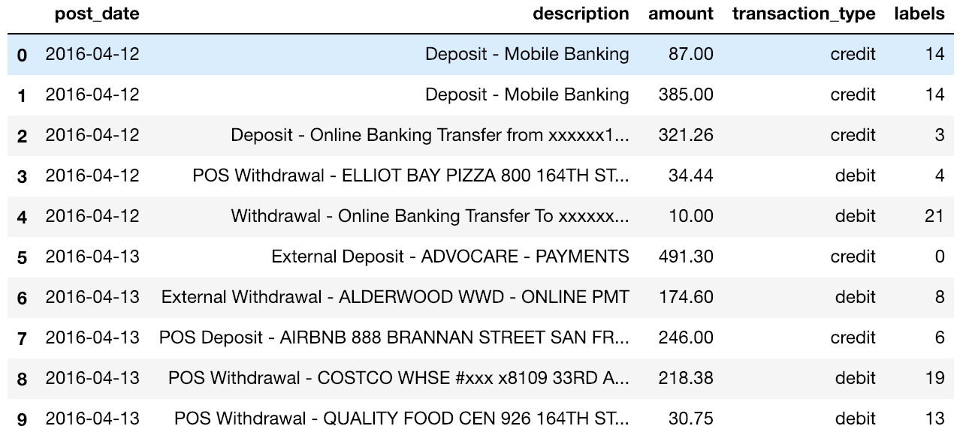
Cluster based on Similarity of Transactions
Data from Lead ID:318465
Totally 2063 transactions.
“post_date”
“description”,
“transaction_type”,
“amount”,
as major elements to measure the similarity between transactions.
Assumed 30 clusters.
Purpose:
We want to group together all transactions with similar ‘description’ and ‘transaction_type’.
Also, their ‘post_date’ and ‘amount’ should be similar.

Slide 29
Cluster Result
After the cluster, all data are grouped into 30 different clusters.
All four elements together decide which cluster each row should belong to.
Labels stand for which cluster group it belongs to.
While clustering,
post_date is standardized as percentage of the newest date;
Amount is standardized as percentage of the maximum.
Transacition_type is transferred to 1 as credit and 0 as debit.
Description has special pattern for different kinds of transactions, so it was transferred as the length of all characters, and standardized as percentage of maximum length.

Slide 30
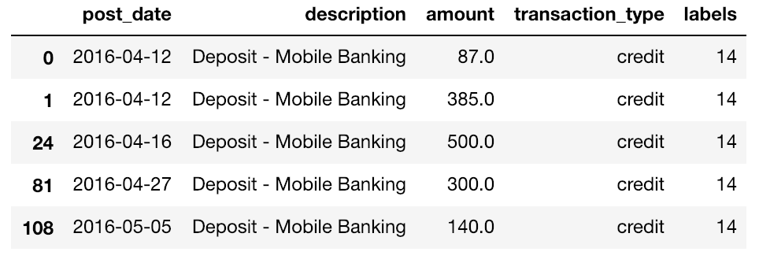
The first row belongs to Group 14.
Let’s explore what’s inside Group 14.
Group 14
Shown is the first 5 rows of Group 14. All these transactions have description “Deposit - Mobile Banking”, and transaction_type “credit”.
For first two transactions, they are on the exact same day. For following transactions, they have similar amount and close dates.

Slide 31
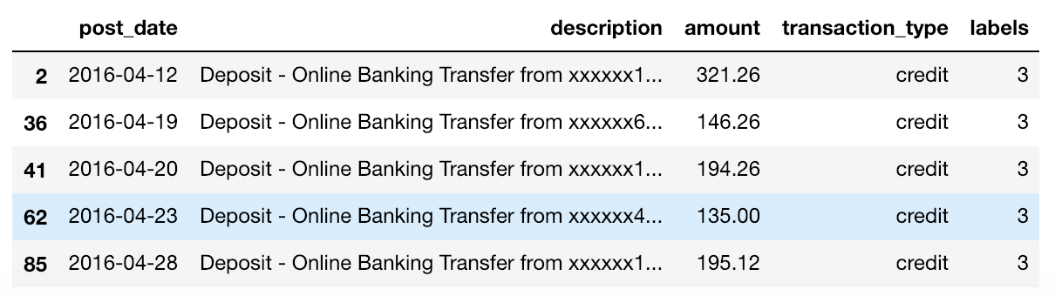
Also, inside Group 3,
Most Transactions have similar description “Deposit - Online Banking Transfer from XX…”, and transaction_type “credit”.
They also have similarity in amount and close dates.
In this way, we can cluster similar business record together, filtering out transactions unrelated to their repayment ability, in short, detecting their default possibility.
Group 3

Slide 32
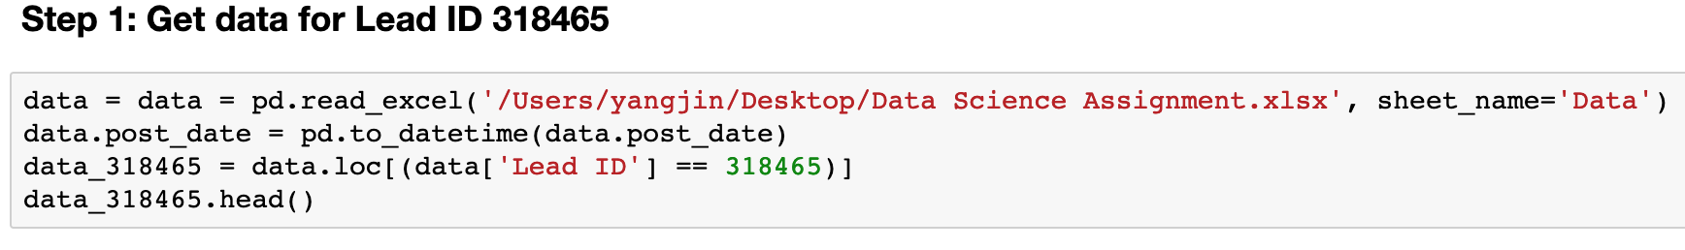
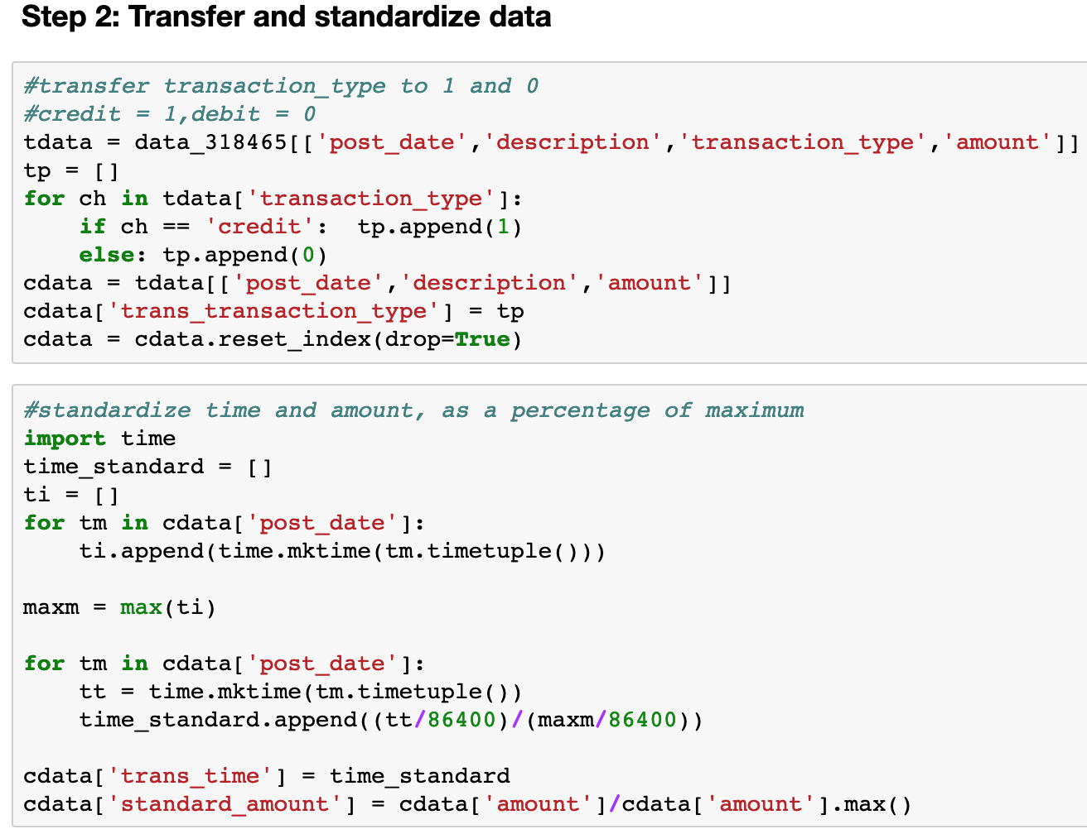
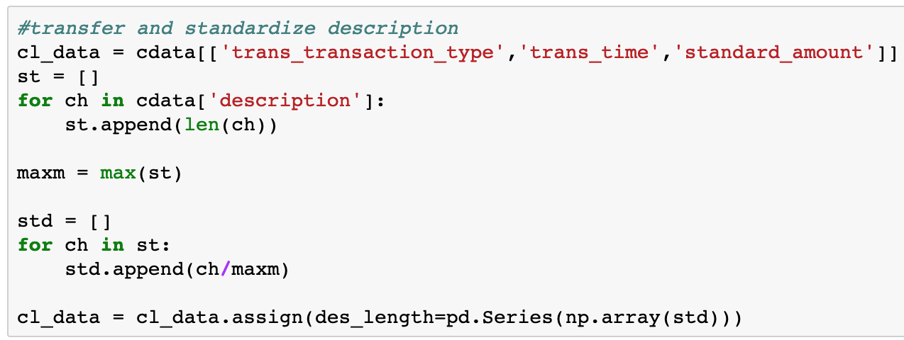
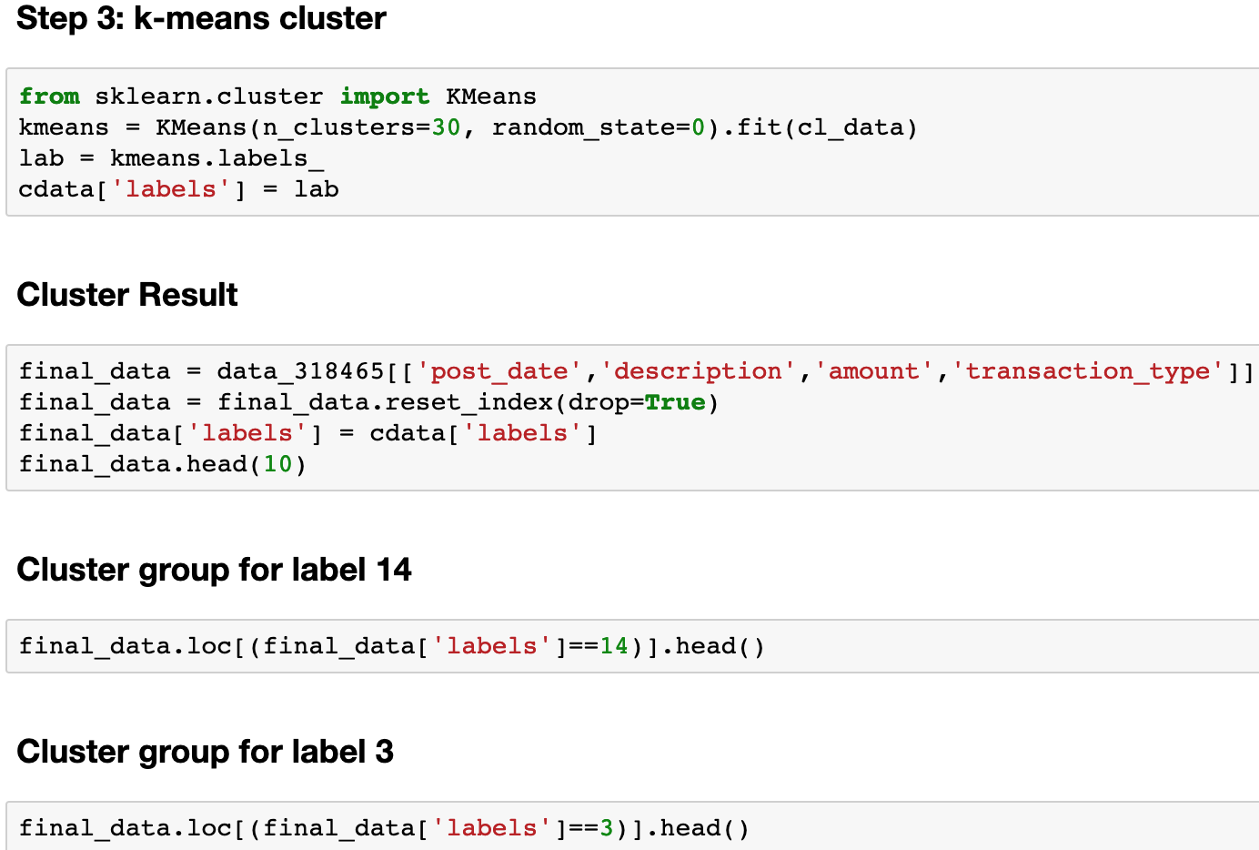
Appendix for Code

